Slide 1





Ten years of hackathons
Peter Murray-Rust
Yusuf Hamied Dept of Chemistry,
University of Cambridge
pm286@cam.ac.uk
, Oxford UK, 2023-05-19

Slide 2
Ten years of hackathons
Peter Murray-Rust
Yusuf Hamied Dept of Chemistry,
University of Cambridge
pm286@cam.ac.uk
Experiments by a community
of committed lively minds
, Oxford UK, 2023-05-19

Slide 3
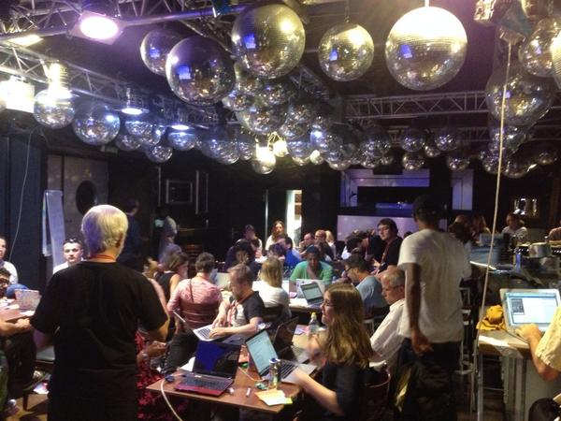
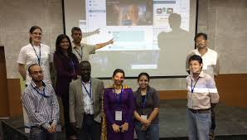
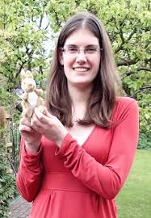
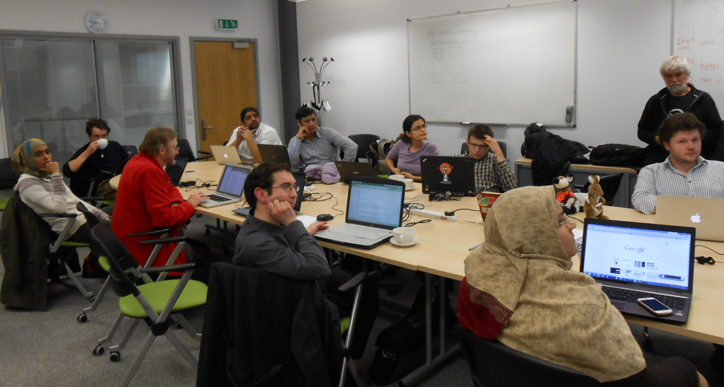
Berlin 2014
Gita Yadav + colleagues
Delhi 2014
Oxford 2013
Jenny Molloy with mascot AMI

Slide 4
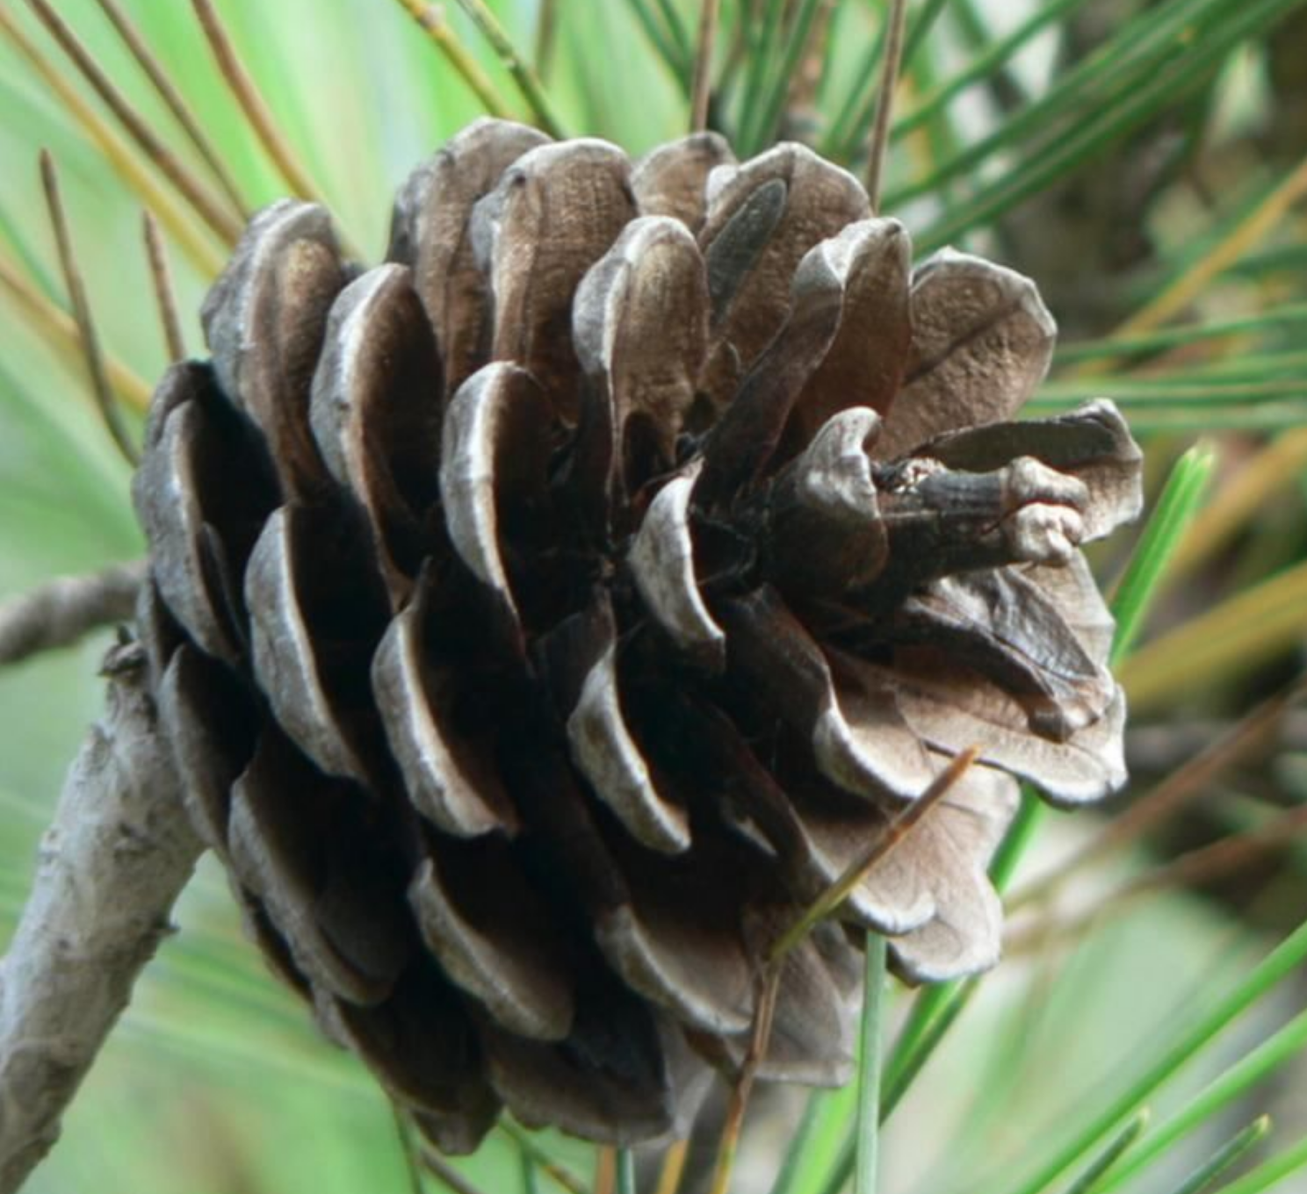
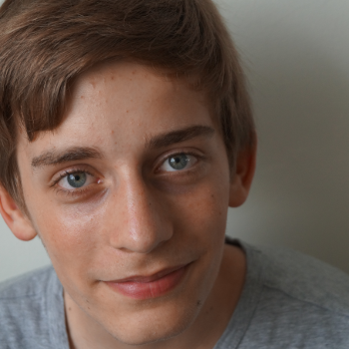
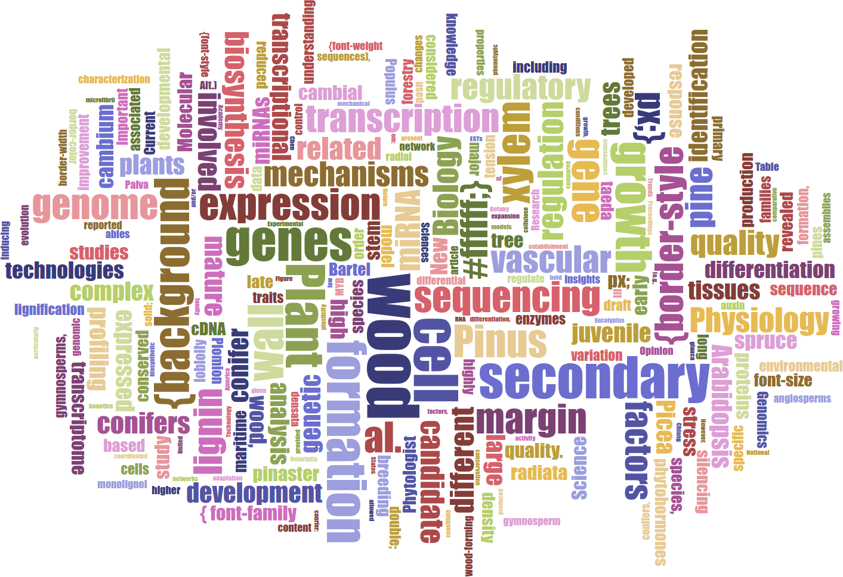
Lars Willighagen
15 years old NL
Wants: extract data about conifers (relations to chemicals, height etc.)
„ I applied to this fellowship to learn new things and combine the ContentMine with two previous projects I never got to finish, and I got really excited by the idea and the ContentMine at large.“
2015 ContentMine Fellowships

Slide 5
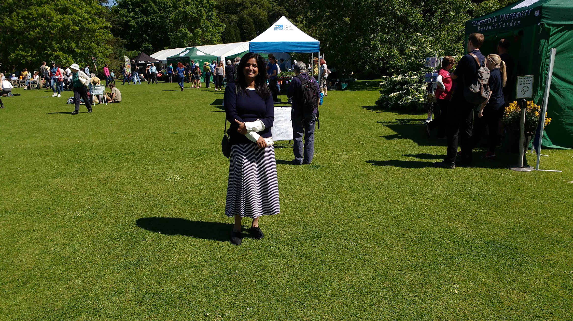
Dr Gitanjali Yadav, Cambridge-India Lecturer
Cambridge University Botanic Gardens

Slide 6
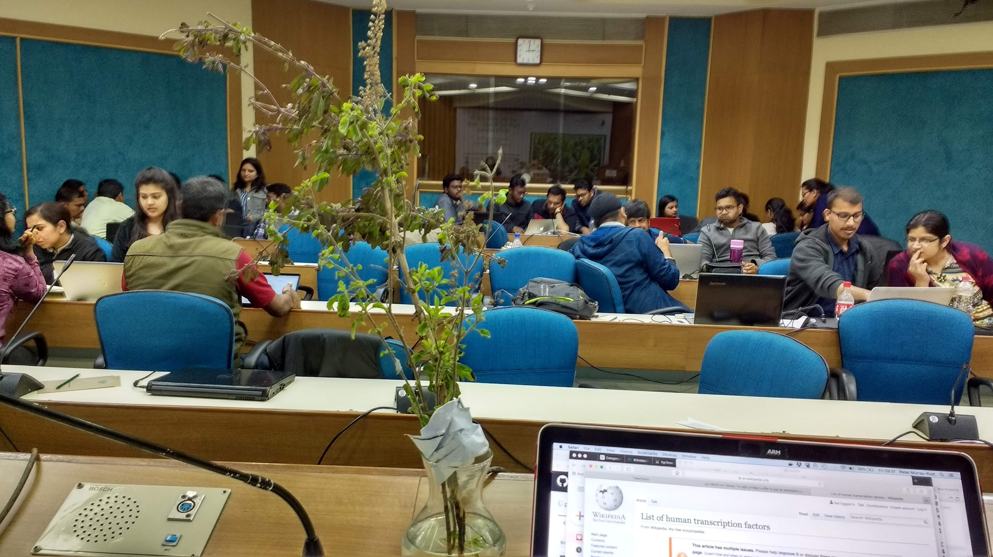
Tigr2ess, NIPGR , 2019

Slide 7
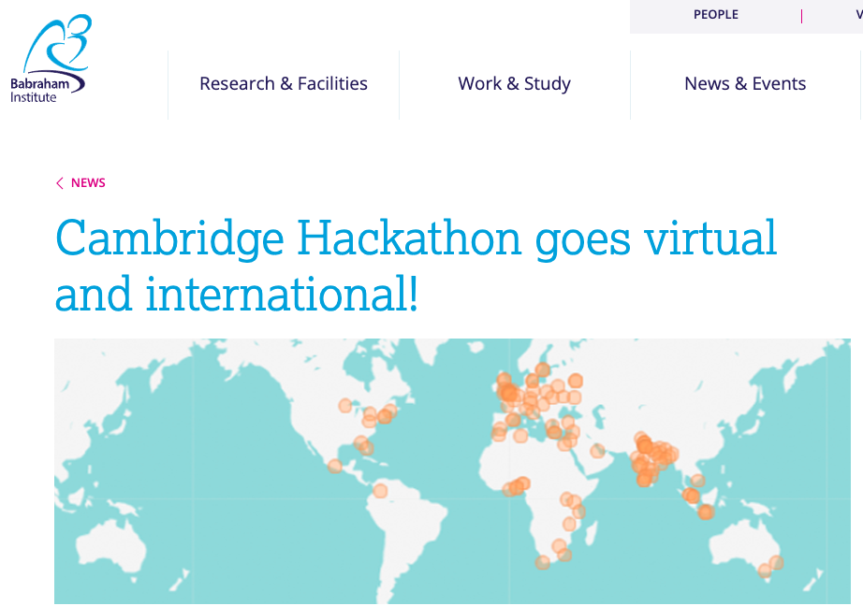
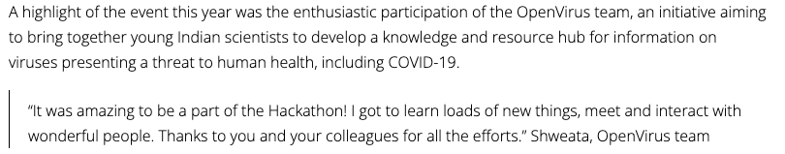
2020
2020 Babraham Institute Cambridge

Slide 8
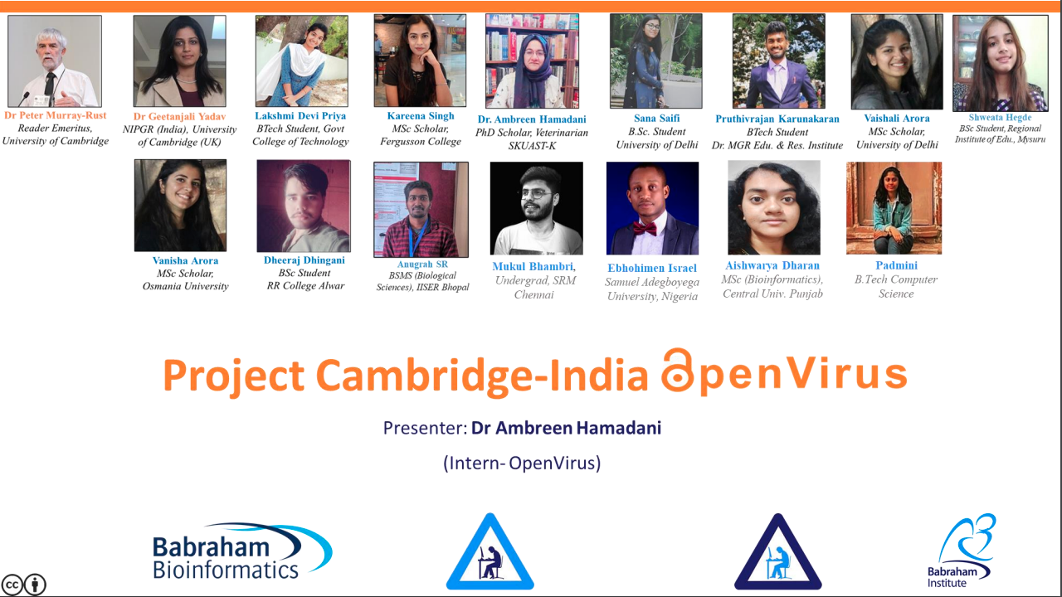
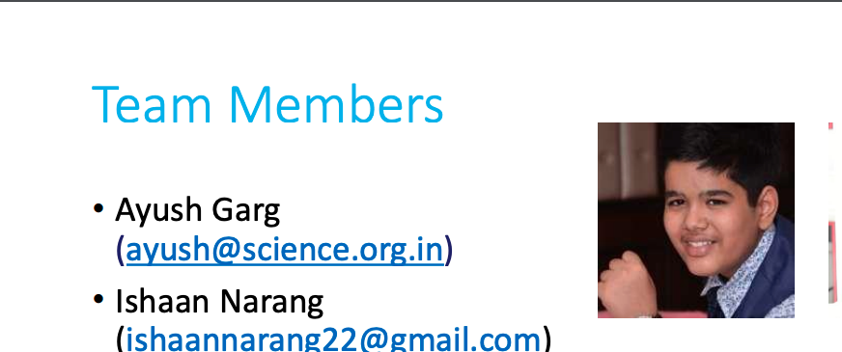
Ayush was on a different team, but then joined openVirus after the event!

Slide 9
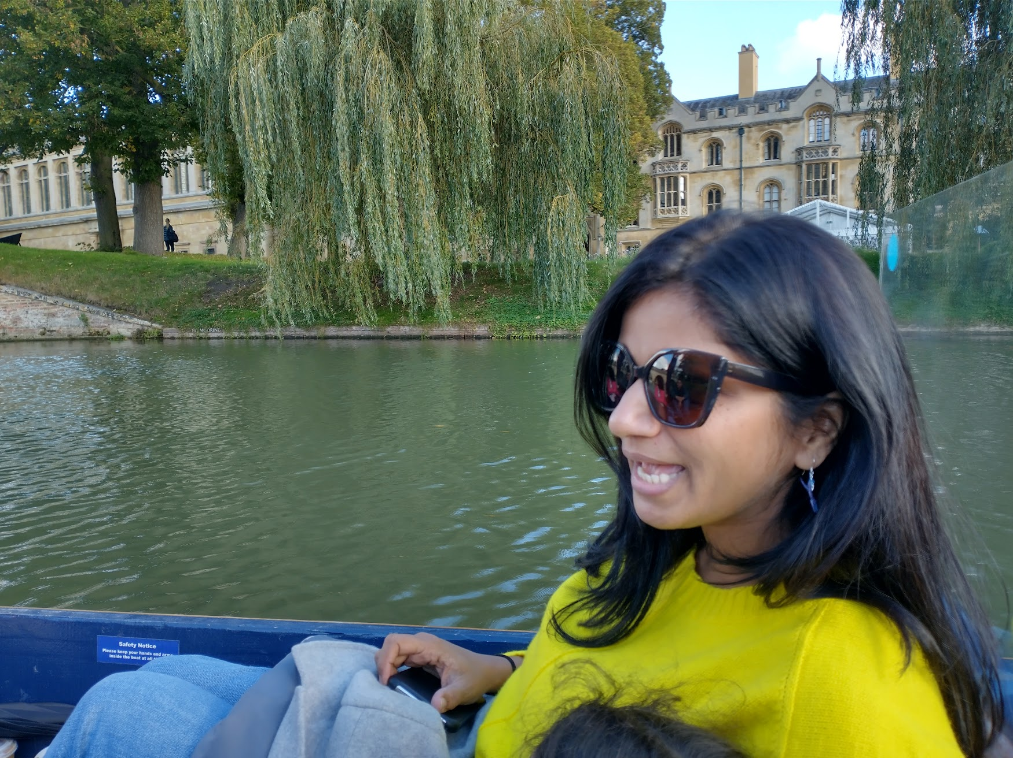
Cambridge, River Cam , 2021

Slide 10
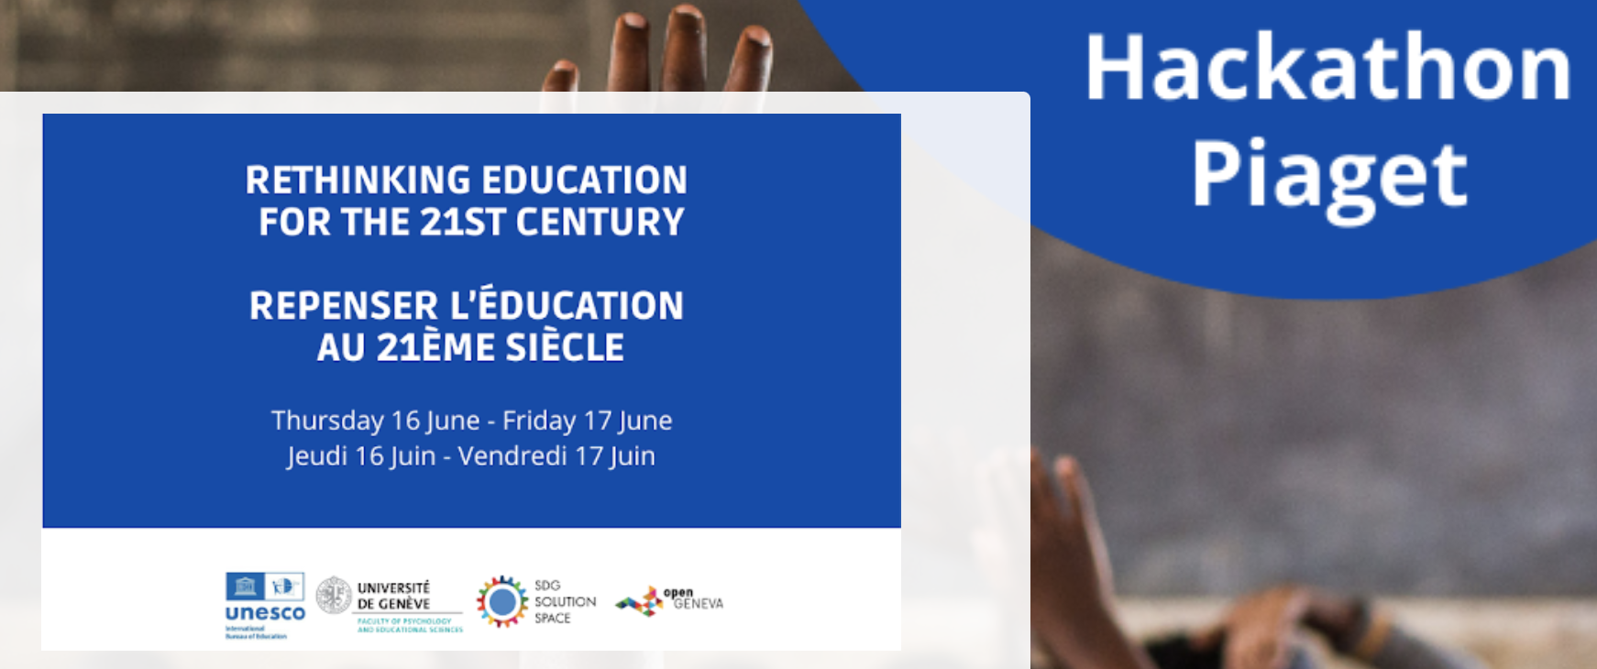
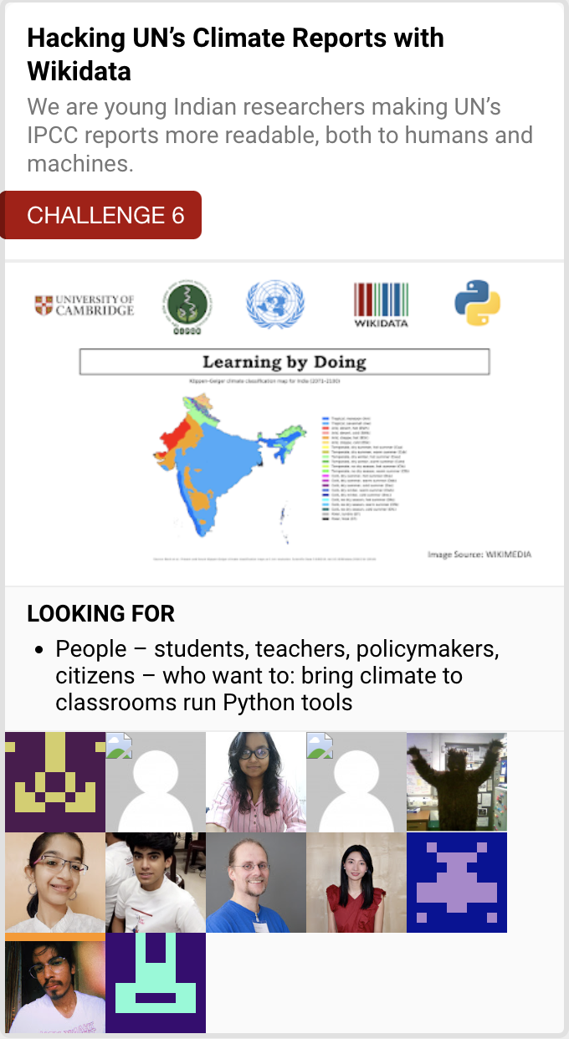
UN + University of Geneva
We won!

Slide 11
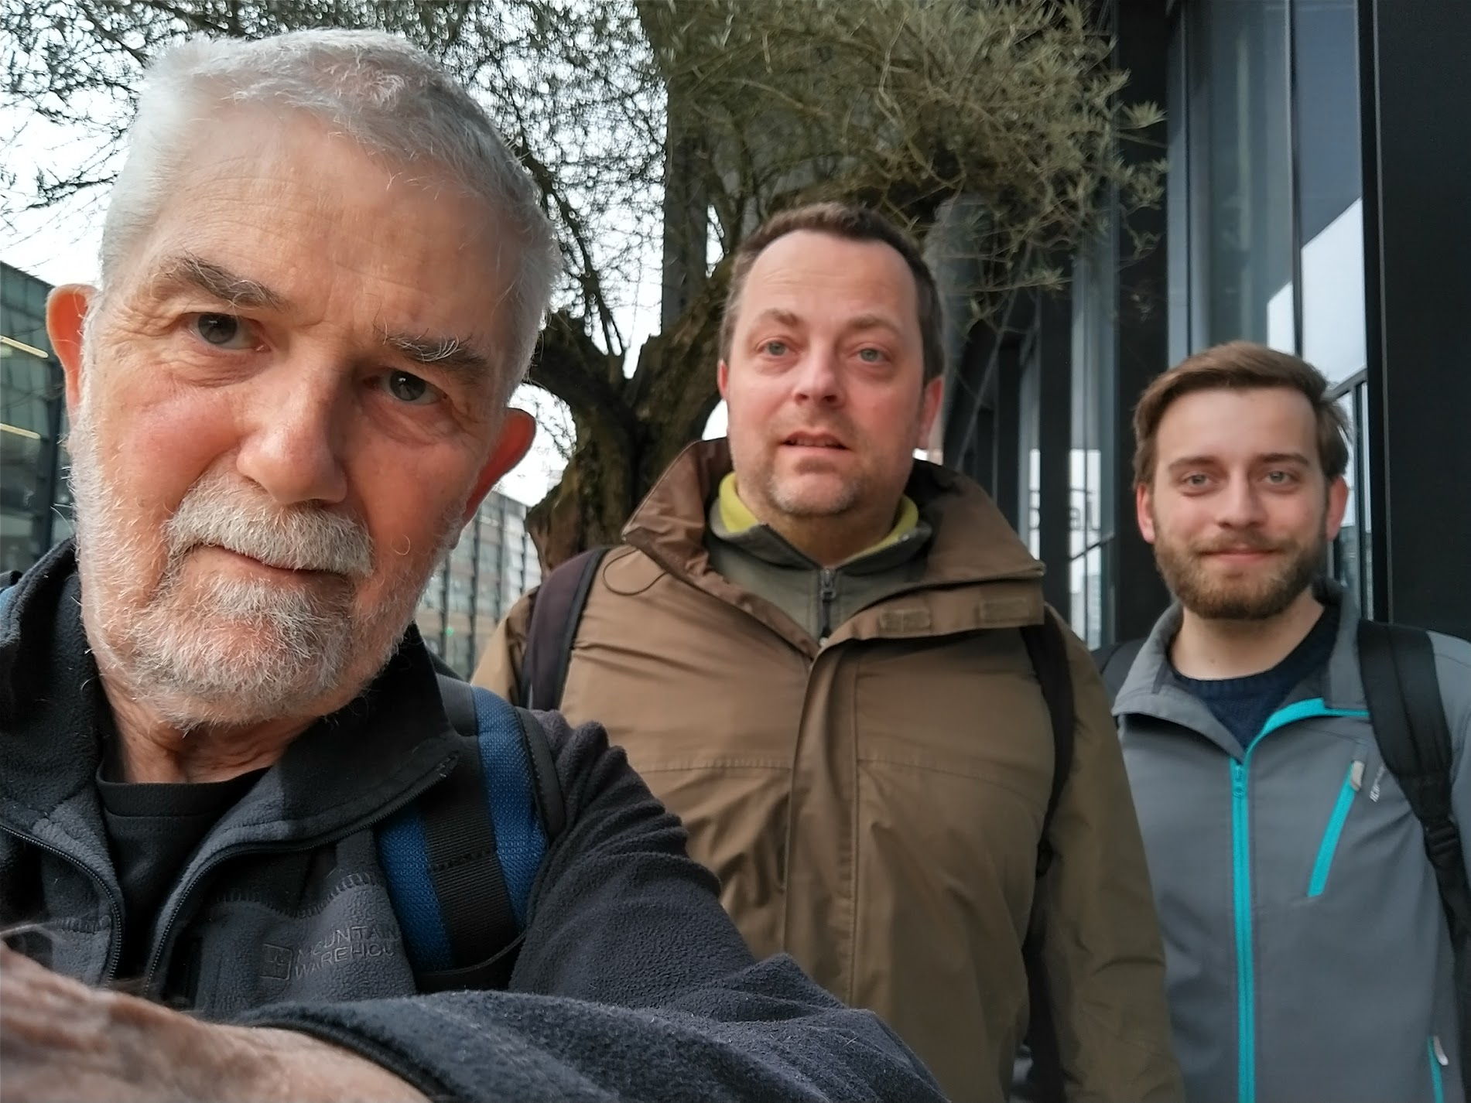
Tilburg 2023 PMR, Egon, Lars Willighagen

Slide 12
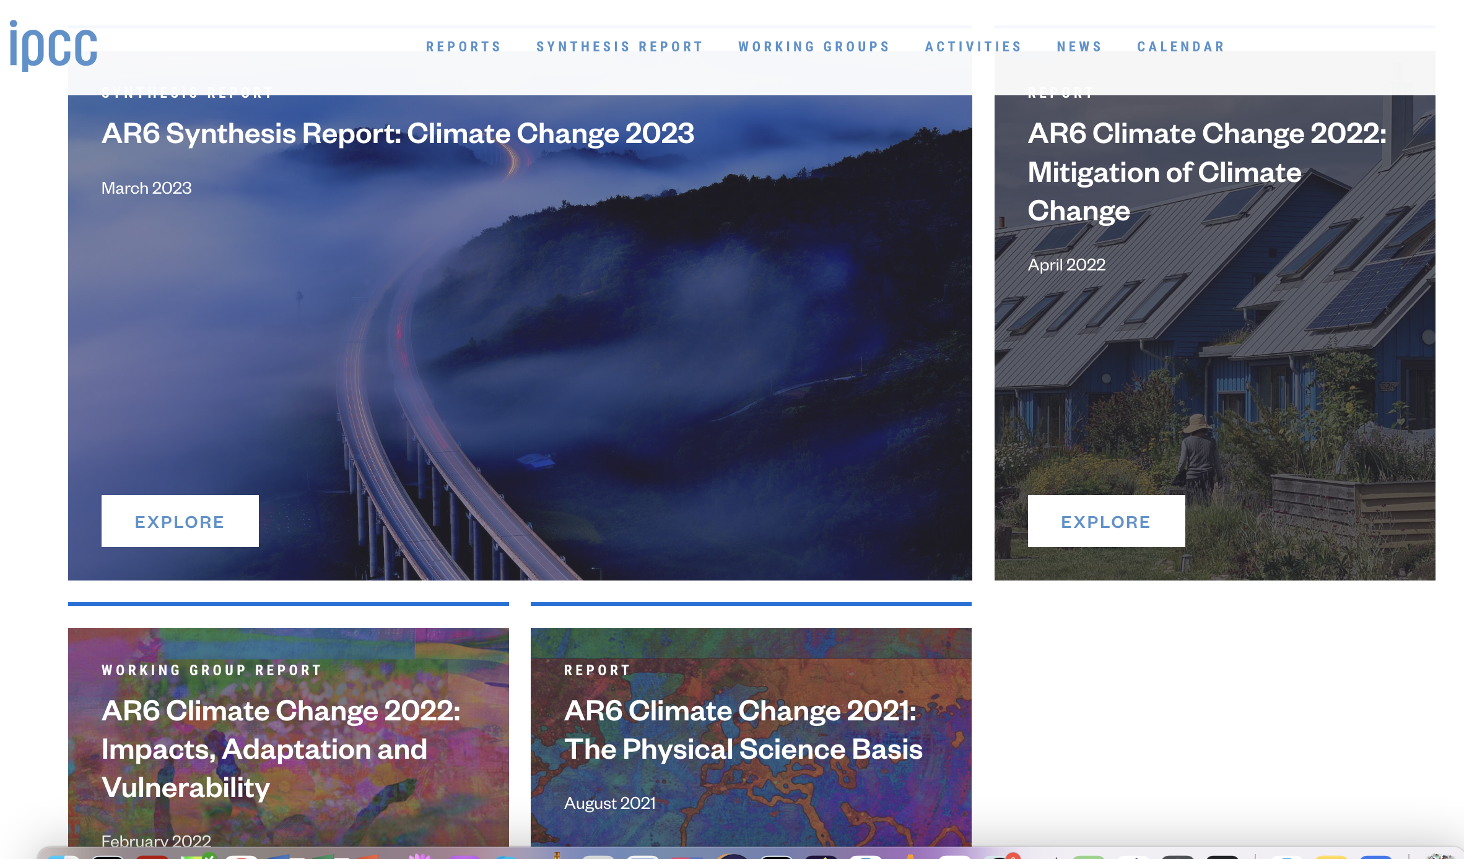
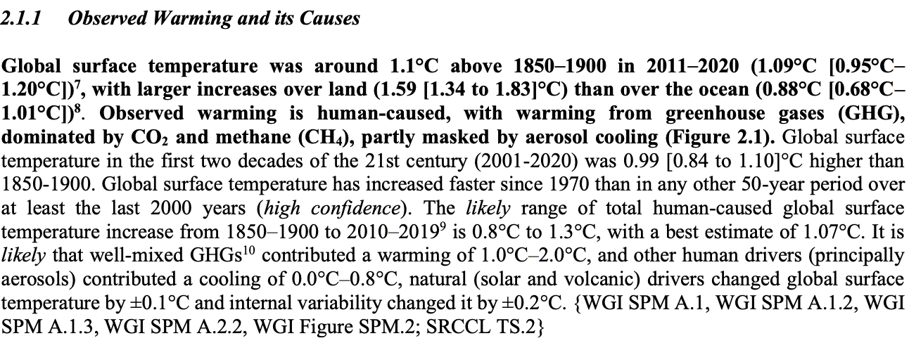
10,000-20,00 pages! 50 Chapters
700 facts in AR6/SYR/LongerReport

Slide 13
Run by a team of 5 young people:
Ananya Singha
Shweata N Hegde
Gayathri jonnalagadda
Sunag Parasu
Karthikeyan V
A model for knowledge creation in multiple fields
Helping the world make decisions for the future
Thanks to NIPGR for sponsorship

